Slide 1
QUANTITATIVE FOUNDATIONS
(SAMPLE SLIDES)
Copyright 2017, CareerTopper.com. All rights reserved

Slide 2
SIMPLE INTEREST AND COMPOUND INTEREST
SIMPLE INTEREST
COMPOUND INTEREST
The interest charged on the principal for the entire loan term
It is easy to calculate.
Simple Interest = p*n*r
where,
p = principal
n = number of years
r = rate of interest
Interest on principal as well as the accumulated interest. Hence can be referred as “Interest on Interest.”
It is difficult to calculate.
Compound interest = P${(1+\frac{r}{100})}^{n}$ - P
where,
P = principal
n = number of years
r = rate of interest

Slide 3
FORWARD CONTRACT
A forward contract is a customized contract between two parties to buy or sell an asset at a specified price at a future date.
The initial value of the contract is zero to both the parties during the time of contract initiation.
Generally, the initial value helps to determine investment returns. Since Forward Contracts have Zero Value at Initiation, calculating returns may be difficult.
NOTIONAL PRINCIPAL can help in solving this issue. Lets see how!
Unlike standard futures contracts, a forward contract can be customized to any commodity, amount and delivery date.

Slide 4
NOTIONAL PRINCIPAL
What is Notional Principal?
Notional principal is the nominal amount of the underlying asset on which the cash flows of the derivative instrument is based.
The notional principal is actually never transacted between the counterparties and hence it is considered notional. Hence Returns calculated based on Notional Principal can be misleading.
Return on Notional Principal is calculated by taking the gain or loss on the derivative instrument and dividing it by the notional principal of the underlying security.
For example: The Realized Profit for a 3-month USD-INR contract is Rs. 4 million, for which the Notional Principal (INR equivalent US Dollar Value) was Rs. 40 million, is 10%

Slide 5
As the return on notional principal can be misleading, it is often expressed on a fully collateralized basis. Here, the contract value is matched with the amount equal to the forward contract’s notional principal. The return on these collateralized contracts consists of two components: 1. The risk free return on the collateral 2. The percent change in the derivative value. Return is computed as follows: $R_{fcoll}$=$\ln{(1+R})$ + $R_{f}$
NOTIONAL PRINCIPAL (CONTD)
Example: If the risk free rate is 6% and the return on derivative instrument is 15%, calculate the Fully Collateralised Return. Answer: $R_{fcoll}$=$\ln{(1.15})$ + $6\%$ $R_{fcoll}$= 13.98% + 6% = 19.98%

Slide 6
What is Internal Rate of Return?
INTERNAL RATE OF RETURN
Internal Rate of Return (IRR) is used in capital budgeting to calculate the return on potential investments. The higher a project’s IRR, the more desirable it is to invest in.
The IRR is used by investors and companies to check if returns on their are as per expectations.
Internal Rate of Return is the discount rate which equates a project’s future cash inflows and outflows. At IRR, the Net Present Value (NPV) of all cash flows from a particular project equals to Zero.
IRR can be said as the rate of growth for an investment over an estimated period of time. It is also known as “yield on project”, “economic rate of return” or “discounted cash flow rate of return”.
IRR is used in Private Equity Market, as daily market prices are not easily available
We can state IRR mathematically as follows:
C$F_{0}$+ $\frac{{CF}_{1}}{\left(1+IRR\right)1}$ + $\frac{{CF}_{2}}{{(1+IRR)}^{2}}$ + … + $\frac{{CF}_{T}}{{(1+IRR)}^{T}}$ = 0
where:
C$F_{T}$ = cash flow at time T.

Slide 7
INTERNAL RATE OF RETURN - EXAMPLE
Example: Cash Flows for an investment, which costs Rs. 20000 today, are Rs. 8000 in Year 1, Rs. 8000 in Year 2, Rs. 5000 in Year 3 and Rs. 6000 in the last year. Calculate the IRR for the project.
Answer: Project Cash Flows are: Outflow of - Rs. 20,000 and Inflows of Rs. 8000, Rs. 8000, Rs. 5000 and Rs. 6000 in 4 years.
To equate the outflow and inflow, we can use the IRR formula and get the IRR as 14.26%
C$F_{0}$+ $\frac{{CF}_{1}}{\left(1+IRR\right)1}$ + $\frac{{CF}_{2}}{{(1+IRR)}^{2}}$ + … + $\frac{{CF}_{T}}{{(1+IRR)}^{T}}$ = 0
This may be time-consuming, hence, we can use the Texas Instrument BA II Plus Financial Calculator for computing the IRR.

Slide 8
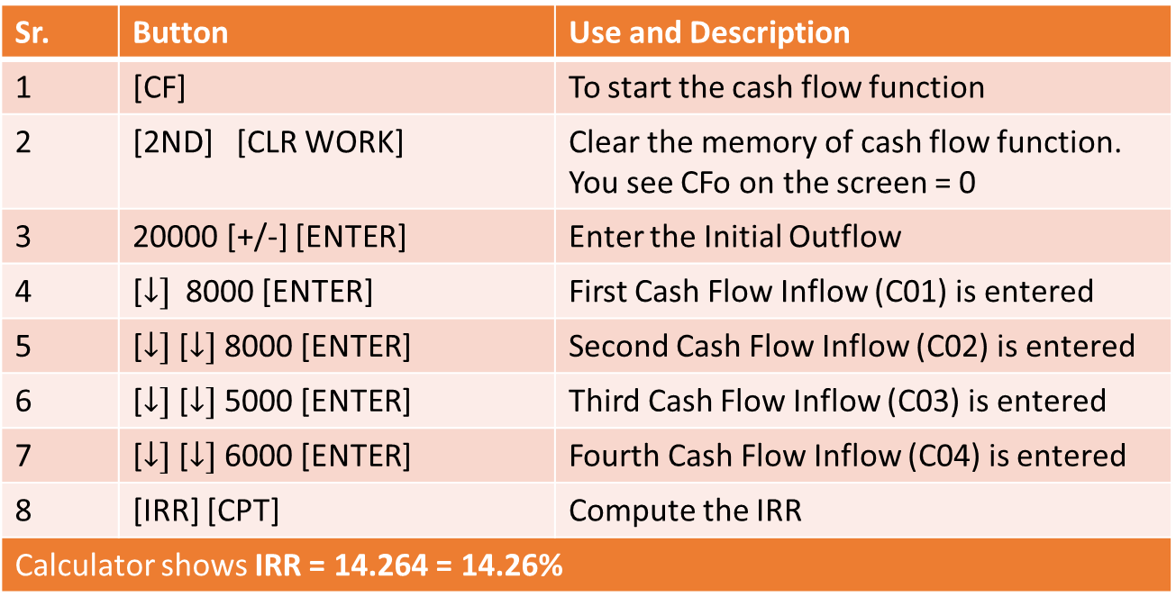
INTERNAL RATE OF RETURN - EXAMPLE
Steps to use the Texas Instrument BA II Plus Financial Calculator for computing the IRR:
Sr. | Button | Use and Description
1 | [CF] | To start the cash flow function
2 | [2ND] [CLR WORK] | Clear the memory of cash flow function. You see CFo on the screen = 0
3 | 20000 [+/-] [ENTER] | Enter the Initial Outflow
4 | [$↓]$8000 [ENTER] | First Cash Flow Inflow (C01) is entered
5 | [$↓]$[$↓]$8000 [ENTER] | Second Cash Flow Inflow (C02) is entered
6 | [$↓]$[$↓]$5000 [ENTER] | Third Cash Flow Inflow (C03) is entered
7 | [$↓]$[$↓]$6000 [ENTER] | Fourth Cash Flow Inflow (C04) is entered
8 | [IRR] [CPT] | Compute the IRR
Calculator shows IRR = 14.264 = 14.26%

Slide 9
INTERNAL RATE OF RETURN - TYPES
LIFETIME IRR
Cash flows of entire investment are available.
POINT-TO-POINT IRR
Appraised value is used for time T and/or investment outflow. All investment cash flows are not available.
SINCE-INCEPTION IRR
Checks performance of the entire fund, since the day it was started.
Cash flows used in each period would be the aggregate cash flows of all portfolio holdings to the fund.
INTERIM IRR
Assumes an appraised value.
There is no terminal appraised value. Period T signifies the end of investment.
Sometimes it is also called “Overall ” IRR.
Period T occurs before the end of the investment.
All investment cash flows are not available.
Every Point-To-Point IRR may not be Since Inception IRR but every Since Inception IRR and Interim IRR may be a Point-To-Point IRR.
Appraised value of portfolio would be used for time T.

Slide 10
INTERNAL RATE OF RETURN - EXAMPLE
_{Life-Time IRR}
CF₀
CF₁
CF₂
CF₃
CF₄
CF₅
CF₆
CF₇
_{Since-Inception IRR}
_{Point-to-Point IRR}
_{Interim IRR}

Slide 11
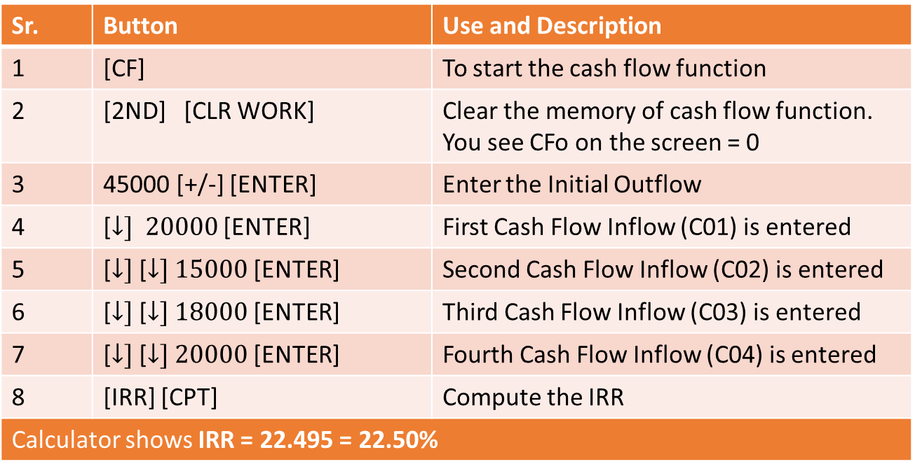
LIFE-TIME IRR - EXAMPLE
Cash Flows for an investment costing Rs. 45,000 today, are Rs. 20,000 in Year 1,
Rs. 15,000 in Year 2, Rs. 18,000 in Year 3 and Rs. 20,000 in the last year. Calculate the Life-time IRR for the project.
Sr. | Button | Use and Description
1 | [CF] | To start the cash flow function
2 | [2ND] [CLR WORK] | Clear the memory of cash flow function. You see CFo on the screen = 0
3 | 45000 [+/-] [ENTER] | Enter the Initial Outflow
4 | [$↓] 20000$ [ENTER] | First Cash Flow Inflow (C01) is entered
5 | [$↓]$[$↓] 15000$ [ENTER] | Second Cash Flow Inflow (C02) is entered
6 | [$↓]$[$↓] 18000$ [ENTER] | Third Cash Flow Inflow (C03) is entered
7 | [$↓]$[$↓] 20000$ [ENTER] | Fourth Cash Flow Inflow (C04) is entered
8 | [IRR] [CPT] | Compute the IRR
Calculator shows IRR = 22.495 = 22.50%
All the investment cash flows are available hence terminal value is not present.

Slide 12
INTERIM IRR - EXAMPLE
Cash Flows for a Rs. 80,000 investment, are Rs. 55,000 in Year 1, Rs. 30,000 in Year 2,
Rs. 18,000 in Year 3 and the Appraised value is Rs. 80,000 in the fourth year. Calculate the Interim IRR for the project.
Sr. | Button | Use and Description
1 | [CF] | To start the cash flow function
2 | [2ND] [CLR WORK] | Clear the memory of cash flow function. You see CFo on the screen = 0
3 | 80000 [+/-] [ENTER] | Enter the Initial Outflow
4 | [$↓] 55000$ [ENTER] | First Cash Flow Inflow (C01) is entered
5 | [$↓]$[$↓] 30000$ [ENTER] | Second Cash Flow Inflow (C02) is entered
6 | [$↓]$[$↓] 18000$ [ENTER] | Third Cash Flow Inflow (C03) is entered
7 | [$↓]$[$↓] 80000$ [ENTER] | Fourth Cash Flow Inflow (C04) is entered
8 | [IRR] [CPT] | Compute the IRR
Calculator shows IRR = 41.637 = 41.64%
All the investment cash flows are not available and hence terminal value is used for the fourth year.

Slide 13
POINT-TO-POINT IRR - EXAMPLE
Consider an investment which was purchased 7 years ago by a Hedge fund for Rs. 1,00,000. The Appraised Value is Rs. 165,000 in beginning Year 4. Cash flows at end of Year 4 is Rs. 65000, Rs. 40,000 in Year 5, Rs. 25,000 in Year 6 and the Appraised value is Rs. 95,000 at end of seventh year. Calculate the Point-To-Point IRR for the project.
Sr. | Button | Use and Description
1 | [CF] | To start the cash flow function
2 | [2ND] [CLR WORK] | Clear the memory of cash flow function. You see CFo on the screen = 0
3 | 165000 [+/-] [ENTER] | Enter the Initial Outflow
4 | [$↓] 65000$ [ENTER] | First Cash Flow Inflow (C01) is entered
5 | [$↓]$[$↓] 40000$ [ENTER] | Second Cash Flow Inflow (C02) is entered
6 | [$↓]$[$↓] 25000$ [ENTER] | Third Cash Flow Inflow (C03) is entered
7 | [$↓]$[$↓] 95000$ [ENTER] | Fourth Cash Flow Inflow (C04) is entered
8 | [IRR] [CPT] | Compute the IRR
Calculator shows IRR = 12.844 = 12.84%
This is an example of Point-To-Point IRR as 4th year and the 7th year values are appraised values.

Slide 14
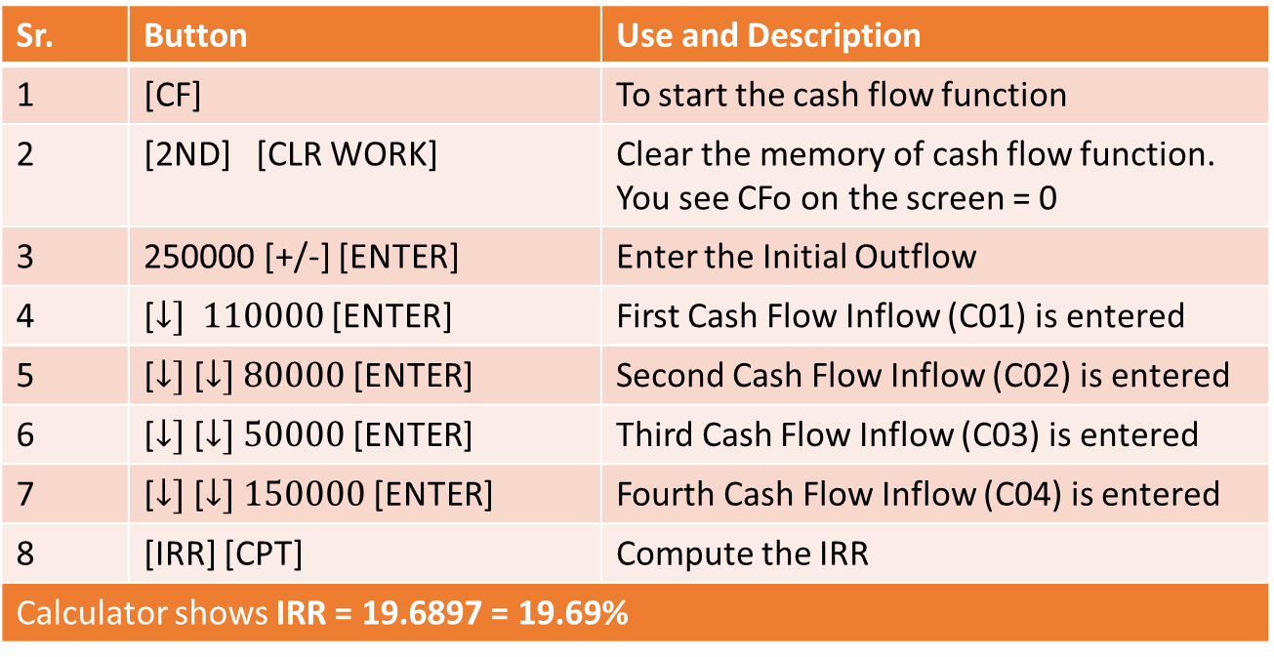
SINCE INCEPTION IRR - EXAMPLE
Consider a portfolio was started by Hedge Fund ABC, 4 years ago with an initial investment of Rs.2,50,000. The returns are Rs. 1,10,000 in Year 1, Rs. 80,000 in Year 2, Rs. 50,000 in Year 3 and the Appraised value is Rs. 1,50,000 in the fourth year. Calculate the Since Inception IRR for the project.
Sr. | Button | Use and Description
1 | [CF] | To start the cash flow function
2 | [2ND] [CLR WORK] | Clear the memory of cash flow function. You see CFo on the screen = 0
3 | 250000 [+/-] [ENTER] | Enter the Initial Outflow
4 | [$↓] 110000$ [ENTER] | First Cash Flow Inflow (C01) is entered
5 | [$↓]$[$↓] 80000$ [ENTER] | Second Cash Flow Inflow (C02) is entered
6 | [$↓]$[$↓] 50000$ [ENTER] | Third Cash Flow Inflow (C03) is entered
7 | [$↓]$[$↓] 150000$ [ENTER] | Fourth Cash Flow Inflow (C04) is entered
8 | [IRR] [CPT] | Compute the IRR
Calculator shows IRR = 19.6897 = 19.69%
This is an example of Since Inception IRR as we evaluated the returns of the investment, since its beginning, using a terminal value for Year 4.

Slide 15
ISSUES WITH IRR – DIFFERENT CASH FLOW PATTERNS
BORROWING TYPE CASH FLOW PATTERN
MULTIPLE SIGN CHANGE CASH FLOW PATTERN
The initial cash flow in this type of pattern is positive and subsequent cash flows are negative.
For example, investments like sale and lease back arrangement, repurchase agreement, etc, in which there is initial cash inflow(sale receipt/cash receipt) and cash outflow(lease payments/interest payments).
The effect of this pattern is that it changes the interpretation of IRR.
A high IRR is not desirable, as IRR denotes the effective cost of borrowing and not the return on investment.
In this pattern, project cash flows are both positive and negative. During the project tenure, cash flows switch signs, multiple times.
As a result, Multiple IRR solutions are derived. Number of IRRs may be equal to number of sign changes, which is not desirable.

Slide 16
ISSUES WITH IRR – SCALE DIFFERENCES
Scale Differences
Issues may arise when comparing two or more investments having Scale Differences.
Scale Differences may be on account of difference in initial investments, discount rates applied, etc.
Example: Consider the following investments:
Investment A with Initial Cost of Rs. 2000 today and cash flows of Rs. 750 for next 5 year only.
Investment B with Initial Cost of Rs. 5 crore today and cash flows of Rs. 1 crore in Year 1, Rs. 1.5 crore in Year 2 and Rs. 2 crore thereafter for 3 years.
Answer: IRR for Investment A is 25.413% and Investment B is 18.375%
We compare Net Present Value (NPV) of both the Investments, assuming a Cost of Capital of 12% for both the Investments.
NPV for Investment A: Rs. 703.58
NPV for Investment B: Rs. 91,80,983.23
Based on IRR comparison, Investment A seems a better prospect. However, on comparison of NPVs of both Investments, Investment B has a larger NPV as compared to Investment A.
Hence, IRR can be misleading, if investment motive is Profit Maximization.

Slide 17
ISSUES WITH IRR – TIMING OF CASH FLOWS
Timing of Cash Flows
Issues may also arise when comparing two or more investments having differences in timing of cash flows. Such differences in timing arise when one investment lasts longer than other.
Due to difference in timings, discount rates may also change overtime in long term projects. IRR may not account for these changes in discount rates, hence making it a poor option.
Example: Consider the following investments of Rs. 1,00,000 in two separate investments A and B, at a Cost of Capital of 12%
Investment A having cash flows of Rs. 30000 for first 6 years, Rs. 35000 for 7th year and zero thereafter.
Investment B having cash flows of Rs. 50000 for first 3 years and zero thereafter.
What is the IRR and NPV of Investment A and Investment B?
Answer: IRR for Investment A and Investment B is 23.37%
Net Present Value (NPV) of Investment A is Rs. 39174 and of Investment B is Rs. 20091. Although IRR is same for both Investments, NPV is much higher for Investment A, which will be preferred over Investment B, for Profit Maximization.

Slide 18
ISSUES WITH IRR – AGGREGATION OF IRRs
Aggregation of IRRs
Issues may also arise when the solutions of several investments are aggregated.
Aggregation of IRRs refers to the relationship between the IRRs for individual investments and the IRR of the combined investment.
The issue arises, because Combined IRR does not equal the average of the Individual IRRs.
Example: Consider the following investments:
Explain how can Aggregation of IRRs be misleading?
Answer: Individual IRR for Investment ABC is 15% and of Investment XYZ is 0% (being in nature of loan). Considering Individual IRRs of 15% and 0%, we may think that the Aggregated IRR of Total Investments (ABC + XYZ) will be between 15% and 0%.
However, the Aggregated Investment has a Negative Return and, hence a negative Aggregated IRR of -3.75%. Therefore, IRR of the Combined Investment is not a Weighted Average of the Individual Investment IRRs.
 | Cash Flow at T0 | Cash Flow at T1
Investment ABC | - Rs. 1,00,000 | + Rs. 1,15,000
Investment XYZ | + Rs. 5,00,000 | - Rs. 5,00,000
Combined Investment | + Rs. 4,00,000 | - Rs. 3,85,000

