Slide 1

ALTERNATIVE INVESTMENTS –
PRIVATE EQUITY
Presented by –
Mr. Archit Lohia
CA, CFA, CAIA, LLB
Copyright 2017, CareerTopper.com. All rights reserved.

Slide 2

WHAT ARE ALTERNATIVE INVESTMENTS?
Alternative Investment is different from a publicly-traded Traditional Investment
Alternative Investments include Investments made in the following assets: (Indicative List)
An Investment that is not simply a long position in:
Equities
Fixed Income
Cash
Hedge Funds
Private Equity
Real Assets (Real Estate, Real Estate Investment Trusts)
Infrastructure
Commodities
Structured Products
(ex. Credit Derivatives)
Others
Question:
Alternative Investments are on
Buy-side or Sell-side?

Slide 3
ALTERNATIVE INVESTMENT FUNDS –
STRUCTURE
Limited Partner/ Accredited Investors
Domestic / Offshore Investors
If Manager and Sponsor are same, then Manager is also General Partner
General Partner
Investment Contribution
Sponsor / Trustee
Fund Manager
AIF
(SEBI Registration)
Sponsor Contribution and/or Trustee Services
Investment Management Services
Management Fees and Carried Interest
Investee Co. 1
Investee Co. 2
Investee Co. 3

Slide 4
ALTERNATIVE INVESTMENT FUNDS –
UNIFIED STRUCTURE
Offshore Fund
Investment Management
Offshore Fund Manager
Cross-border
Fees and Carry
India
Investment Contribution
Automatic Route
Onshore Fund Manager
AIF
Investment Management Services
Management Fees and Carried Interest
Investee Co. 1
Investee Co. 2
Investee Co. 3

Slide 5
ALTERNATIVE INVESTMENT FUNDS –
CO-INVESTMENT STRUCTURE
Offshore Fund
Investment Management
Offshore Fund Manager
Cross-border
Fees and Carry
Investment Advisory Arrangement
India
Co-Investment Arrangement
Onshore Fund Manager
Domestic Investors
Investment Contribution
AIF
Investment Management Services
Management Fees and Carried Interest
Investee Co. 1
Investee Co. 2
Investee Co. 3

Slide 6
ALTERNATIVE INVESTMENT FUNDS –
CATEGORIES
Increasing Risk, by Category
Category I
Invest in socially or economically desirable ventures.
Examples: 1. Venture Capital Funds, 2. SME Funds, 3. Social Venture Funds 4. Infrastructure Funds
Category II
Funds not falling in Category I and Category III
Not allowed to take leverage, except to meet day-to-day operations.
Category III
Funds employ diverse or complex trading strategies
Examples: 1. Debt Funds 2. Private Equity Funds
Allowed to take Leverage and Investments in Derivatives.
Example: Hedge Funds

Slide 7
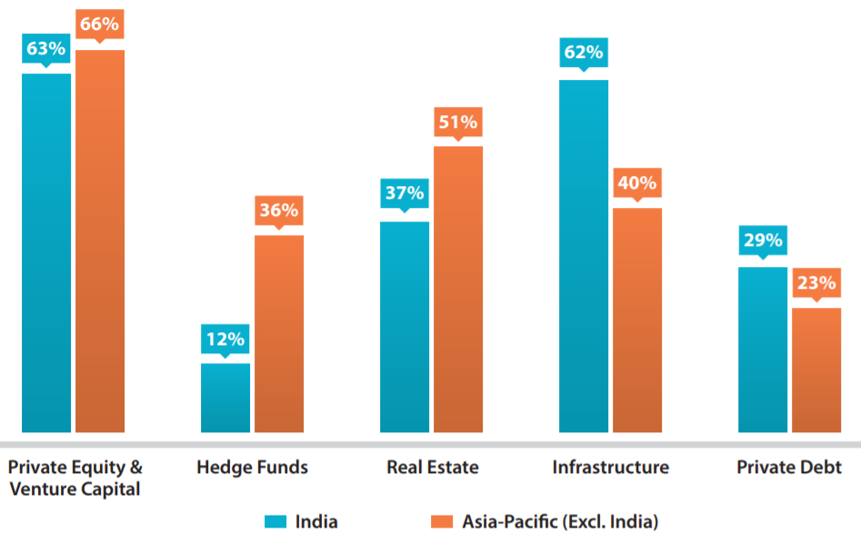
ALTERNATIVE INVESTMENT FUNDS –
QUIZ
Which Alternative Investment Asset Class do Institutional Investors prefer to allocate Funds to, in India?
Source: Preqin, August 2017

Slide 8
PRIVATE EQUITY FUND – STRUCTURE AND FEES
PE Fund Structure and Manager Fees
  Committed Capital: Capital provided to the Fund by investors.
    This amount is “Drawn-down” over a period of 3-5 years. Draw-down period is decided by the Fund Manager.
    It can be called at initiation also.
    Management Fees: 1 – 3% of the Committed Capital. (not Invested Capital)
    Incentive Fees: 20% of Profits.
      Profits are not earned till investors’ initial capital is returned by the fund.
    Distribution: Types of Distribution:
      Deal-by-Deal: Preferred by GPs
      Fund as a Whole
    Claw-back Provision: If Portfolio returns are High earlier and Decline later, then this Provision requires the Fund Manager to return any periodic incentive fees paid, if profits decline in further years from Company Exits.

Slide 9
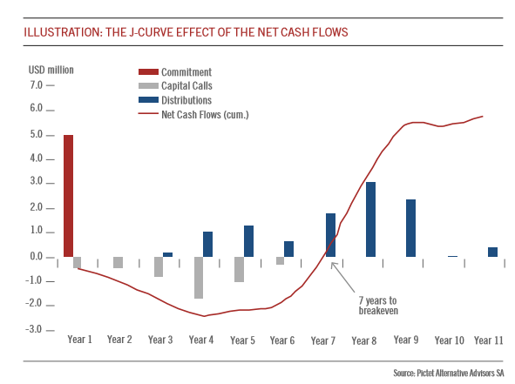
PRIVATE EQUITY FUNDS –
J-CURVE EFFECT
Early years of a private equity fund are characterised by negative cash flows – due to Capital Calls, Management Fees, Cost of Investments, etc.
The Chart shows the Fund does not return any capital until year 3, whereas capital is called in the meantime.
Once the fund starts to exit the early deals, distributions are made to investors.
Consequently, the net cash flows of the fund break even in year 7 and become positive.
J-Curve - Name given to the line, shaped as a “J”, representing the cumulated net cash flows of a private equity fund during its life.

Slide 10
PRIVATE CAPITAL – EQUITY FORMS
Venture Capital (VC)
Provides equity financing to start-ups without any track record or business size.
Leveraged Buyout (LBO)
In an LBO, the equity of a public company is purchased using a small amount of investor capital and a large amount of debt, secured by the assets of the company.
Venture-capitalists take senior equity stakes in the high-risk, illiquid and unproven business ideas of the promoters
This is done to exploit tax advantages, improving operating efficiency and profitability and take the company public again.
Intent is to generate large profits through the success of the businesses, which go public, through sale or an IPO.
Cash flow generated from the firm is used to service the debt taken to invest.

Slide 11
PRIVATE EQUITY - FORMS
Categories of Private Equity Investments
Categories - Based on the Company’s Stage of Development | Example – A Company in the business of manufacturing clothes
Stage 1: Pre-Seed Funding/Angel funding: The company often perfects its business plan and starts building its management team i.e. Ideation stage Pre-seed funding refers to the initial capital a company brings in that comes from friends, family members. | Company starts research and validates the business model. Friends or entrepreneurs invest on feasibility reports and viability.
Stage 2: Seed Funding: Funds are used to develop the product or service and prove that customers want to buy it. Capital needed to grow business and, at the very least, gain proof of concept. | Company does Pre-startup R&D. Product development Testing and designing Samples of product is made
Stage3: Early-stage Investment (Series A & B) Series A - Providing enough capital for 1 to 2 years of operations. This can be used in product development, marketing, employee salaries, etc. Series B is the round that follows series A in early stage financing. | Company starts normal production output Marketing activities are started Salaries to labour and workmen increase, as team-size increases

Slide 12
PRIVATE EQUITY – VENTURE CAPITAL
Categories of Venture Capital Investments
Categories - Based on the Company’s Stage of Development | Example – A Company in the business of manufacturing clothes
Stage 4: Later-Stage Investment (Series C & D) Series C & D – Later-stage investments in companies having a developed production and sales process and is fully operating as a commercial entity. Funding is provided for expansion of production facilities or increasing sales through a robust marketing campaign. | For expansion of manufacturing units and investing in new plant and machinery. The company expects revenue growth through increased marketing and wide-distribution network.
Stage 5: Mezzanine Financing: Mezzanine capital, often provided by private equity firms, is capital provided either as equity, debt, or a convertible note that is provided to a company just prior to its Initial Public Offering. | For expansion and growth of business via public offering.

Slide 13

THANK
YOU
Contact Details:
Name: Archit Lohia
Email: archit@careertopper.com
Mob: +91-9819514584
Website: www.careertopper.com
This material prepared by CareerTopper.com is intended to provide general information on a particular subject or subjects and is not an exhaustive treatment of such subject(s). CareerTopper.com, by means of this material, is not rendering professional advice or services. The information is not intended to be relied upon as the sole basis for any decision which may affect you or your business. Before making any decision or taking any action that might affect your personal finances or business, you should consult a qualified professional adviser.
This material may contain confidential and proprietary information, therefore any further distribution of this material or disclosure of the contents thereof is strictly prohibited.
Copyright 2015, CareerTopper.com. All rights reserved.

