Slide 1
COMMODITY MARKETS
Presented by –
Mr. Archit Lohia
CA, CFA, CAIA, LLB
Copyright 2017, CareerTopper.com. All rights reserved.

Slide 2
COMMODITY – AS A DIRECT INVESTMENT
Types of Commodities Investments
Comparison of Asset Class Performance
DIRECT INVESTMENT in Physical Products:
Investing in Commodities:
Ex: Agricultural Products, Precious Metals, Base Metals, Crude Oil, Energy Products, etc.
Investing in Companies Manufacturing Commodities:
Ex: ONGC, Coal India, REC, etc.
Market Participants:
Hedgers
Speculators
Investors and Arbitragers
Producers – Farmers
Consumers
ASSET CLASS | 2019 | 2020
Equity Nifty | 11.66% | 14.52%
Gold | 23.67% | 31.05%
Term Deposit > 1 Year | 6.80% | 6.20%
10 Year G- Sec yield | 6.91% | 6.62%
Cash (T-Bill 91 Days) | 5.32% | 5.10%
Avg. Inflation | 7.66% | 4.95%

Slide 3
CTA AND MANAGED FUTURES
A Commodity Trading advisor (CTA) is an individual or firm who provides advice regarding the buying and selling of futures contracts and options on futures in commodities.
CTA’s require a Commodity Trading Advisor (CTA) Registration, as mandated by the National Futures Association (NFA), USA.
Managed Futures refers to active trading and managing risk of futures and/or forwards on physical commodities and/or financial assets to enhance returns and diversification.

Slide 4
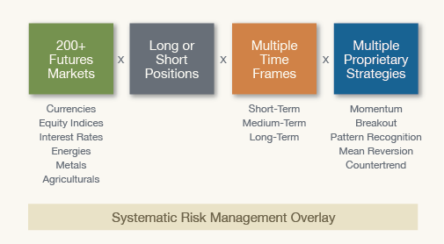
MANAGED FUTURES - STRATEGIES
Global Futures Markets
Systematic Trading Systems

Slide 5
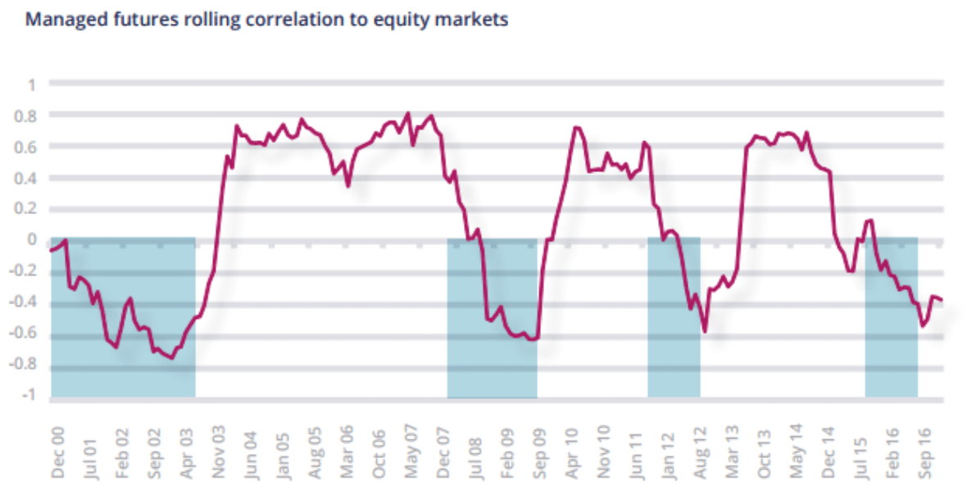
CORRELATION OF CTA’s AND EQUITY

Slide 6
HEDGE FUND – CORRELATION AMONG HEDGE FUND STRATEGIES
Source: BNP Paribas Hedge Fund Centre

Slide 7
CONTANGO AND BACKWARDATION
Contango
Situation: Hedgers go long in futures (as they are users of commodities).
Example: A Cereal Company wanting to buy corn.
Speculators will go Short in those Futures. For Speculators to trade:
Futures Contract Price must be More than Expected Spot Price [F₀ > E(S_{T})]
Futures Price must continually decrease during the term of the contract.
Contango: When Futures Price is Above Spot Price.
The asset exhibits Negative Systematic Risk

Slide 8
CONTANGO AND BACKWARDATION
Backwardation
Situation: Hedgers want to short futures (as they are long in commodities).
Example: A Farmer wanting to sell his wheat produce.
Speculators will go Long in those Futures. For Speculators to trade:
Futures Contract Price must be less than Expected Spot Price [F₀ < E(S_{T})]
Futures Price must continually increase during the term of the contract.
Backwardation: When Futures Price is below Spot Price.
The asset exhibits Positive Systematic Risk

Slide 9
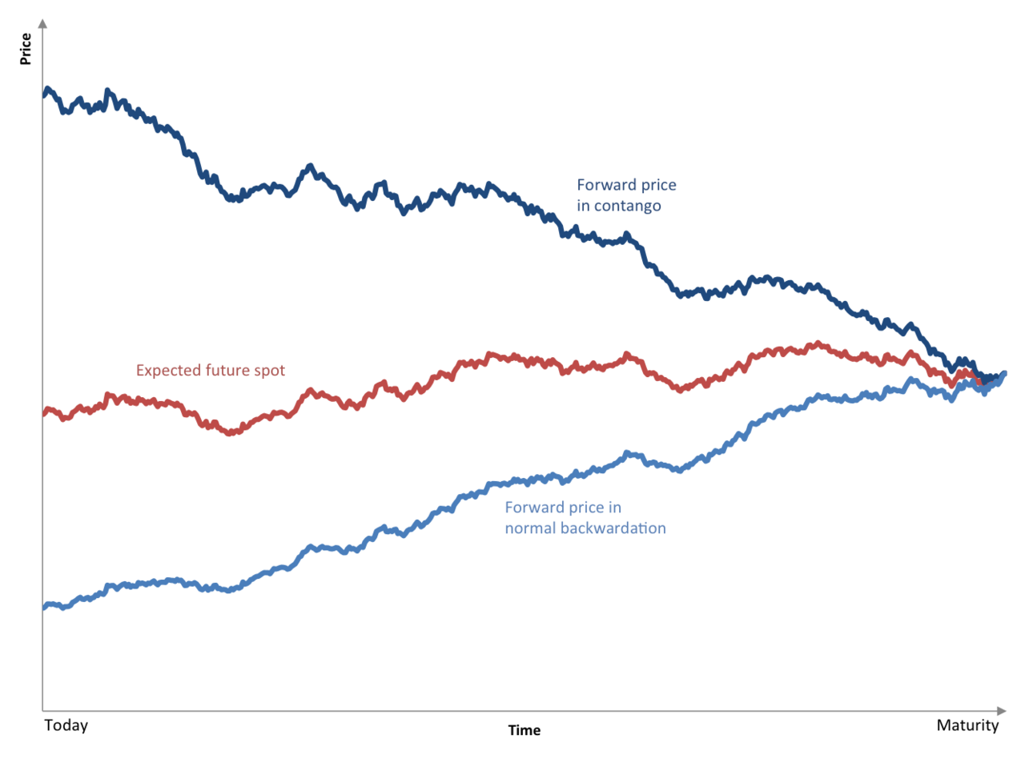
CONTANGO AND BACKWARDATION
Contango and Backwardation

Slide 10
THANK
YOU
Contact Details:
Name: Archit Lohia
Email: archit@careertopper.com
Mob: +91-9819514584
Website: www.careertopper.com
This material prepared by CareerTopper.com is intended to provide general information on a particular subject or subjects and is not an exhaustive treatment of such subject(s). CareerTopper.com, by means of this material, is not rendering professional advice or services. The information is not intended to be relied upon as the sole basis for any decision which may affect you or your business. Before making any decision or taking any action that might affect your personal finances or business, you should consult a qualified professional adviser.
This material may contain confidential and proprietary information, therefore any further distribution of this material or disclosure of the contents thereof is strictly prohibited.
Copyright 2017, CareerTopper.com. All rights reserved.

